Slide 1
Word2vec

Slide 2
Word2vec
Word2vec is one of the most popular technique for word embeddings using a two-layer neural network.
Its input is a text corpus and its output is a set of vectors.
A well-trained set of word vectors will place similar words close to each other in that space. For instance, the words women, men, and human might cluster in one corner, while yellow, red and blue cluster together in another.

Slide 3
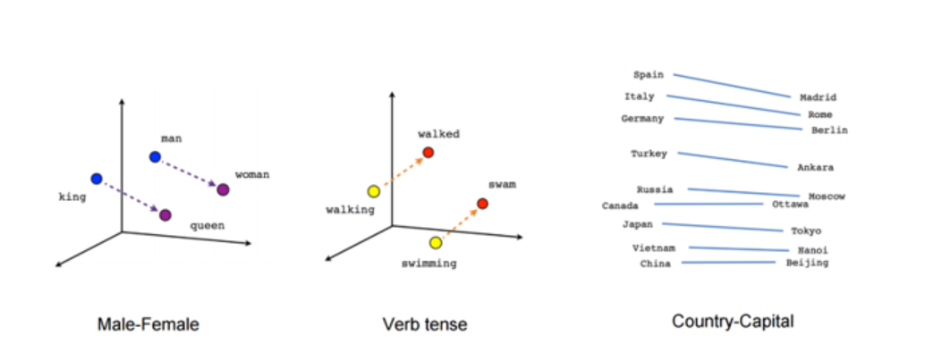

Slide 4
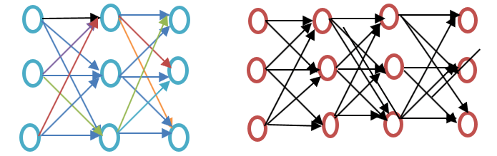
Shallow Neural Network
The shallow neural network consists of only a hidden layer between input and output whereas deep neural network contains multiple hidden layers between input and output. Input is subjected to nodes whereas the hidden layer, as well as the output layer, contains neurons.

Slide 5
Shortcoming of Bag of Words method
It ignores the order of the word, for example, this is bad = bad is this.
It ignores the context of words. Suppose If I write the sentence "He loved books. Education is best found in books". It would create two vectors one for "He loved books" and other for "Education is best found in books." It would treat both of them orthogonal which makes them independent, but in reality, they are related to each other
To overcome these limitation word embedding was developed and word2vec is an approach to implement such.

Slide 6
There are two main training algorithms for word2vec, one is the continuous bag of words(CBOW), another is called skip-gram.
difference between two methods is that CBOW is using context to predict a target word while skip-gram is using a word to predict a target context.
For example, if w_{i-1},w_{i-2},w_{i+1},w_{i+2}are given words or context, CBOW model will provide w_{i}
If w_{i} is given, skip gram will predict the context or w_{i-1},w_{i-2},w_{i+1},w_{i+2.}

Slide 7
What is Gensim?
Gensim is a topic modeling toolkit which is implemented in python. Topic modeling is discovering hidden structure in the text body. Word2vec is imported from Gensim toolkit.
Genism word2vec requires that a format of ‘list of lists’ for training where every document is contained in a list and every list contains lists of tokens of that document. At first, we need to generate a format of ‘list of lists’ for training the model word embedding.

Slide 8
Genism word2vec Model Training
>>> model = Word2Vec(sent, min_count=1,size= 50,workers=3, window =3, sg = 1)
size: The number of dimensions of the embeddings and the default is 100.
window: The maximum distance between a target word and words around the target word. The default window is 5.
min_count: The minimum count of words to consider when training the model; words with occurrence less than this count will be ignored. The default for min_count is 5.
workers: The number of partitions during training and the default workers is 3.
sg: The training algorithm, either CBOW(0) or skip gram(1). The default training algorithm is CBOW.

Slide 9
Avg Word2Vector
We need to give large text corpus where for every word it creates a vector. it tries to learn the relationship between vector automatically from raw text. larger the dimension it has, larger it is rich in information the vector is.
properties:
if word w1 and w2 are similar than vector v1 and v2 will be closer.
automatic learn the relationship between words/vector.

Slide 10
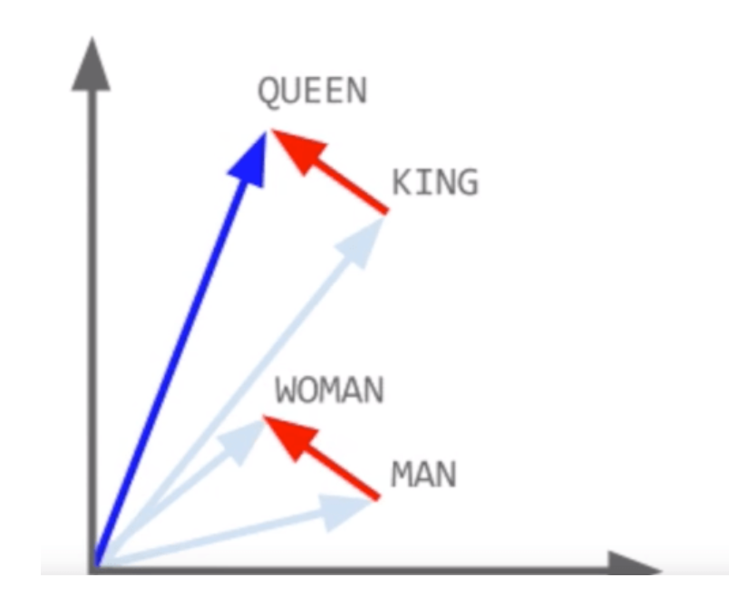

Slide 11
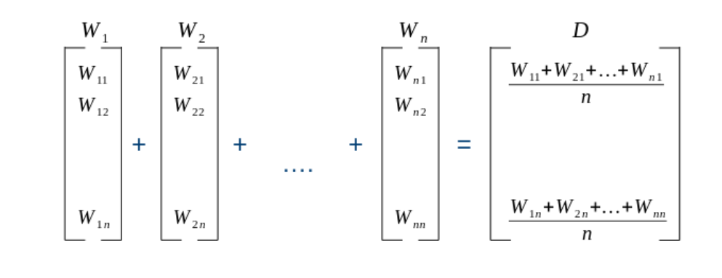
how to convert each document to vector?
suppose you have w1, w2, …wn word in one document(row). in order to convert into vector.

Slide 12
TFIDF weighted Word2Vec
in this method first, we will calculate tfidf value of each word. than follow the same approach as above section by multiplying tfidf value with the corresponding word and then divided the sum by sum tfidf value.

Slide 13
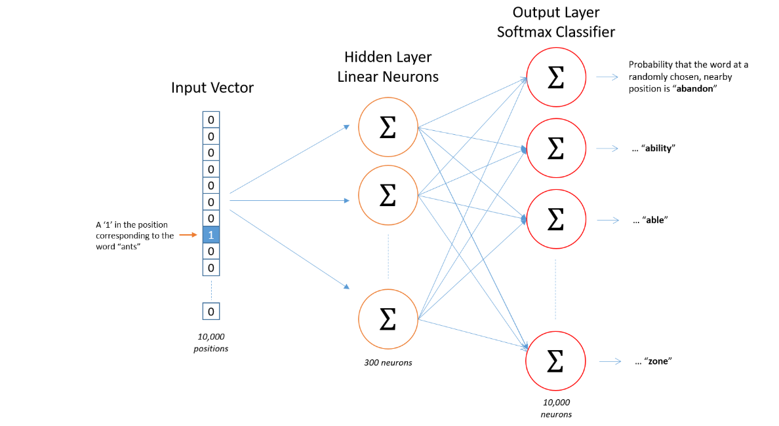

Slide 14
The Hidden Layer
For example, learning word vectors with 300 features. So the hidden layer is going to be represented by a weight matrix with 10,000 rows (one for every word in our vocabulary) and 300 columns (one for every hidden neuron).

Slide 15
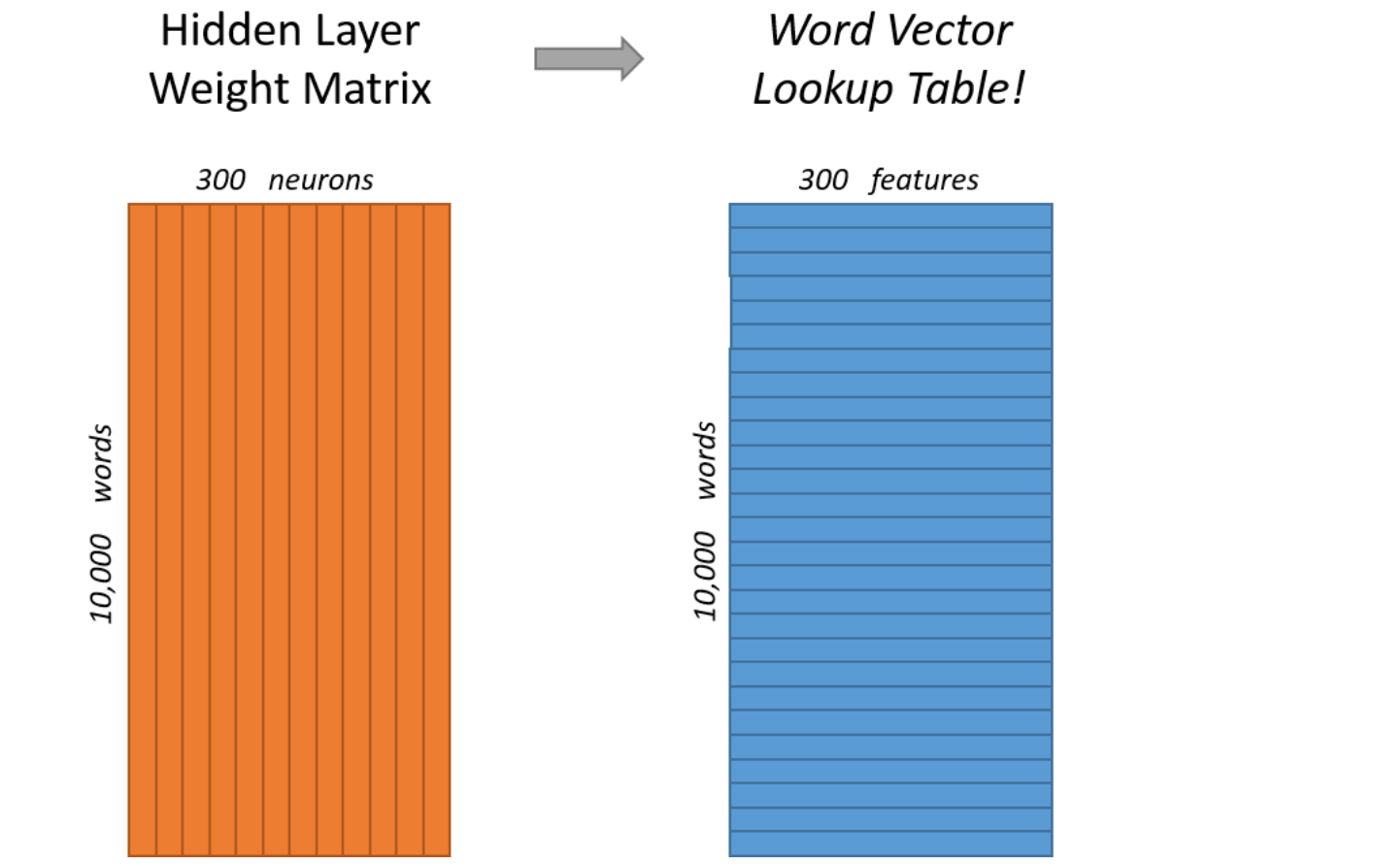

Slide 16
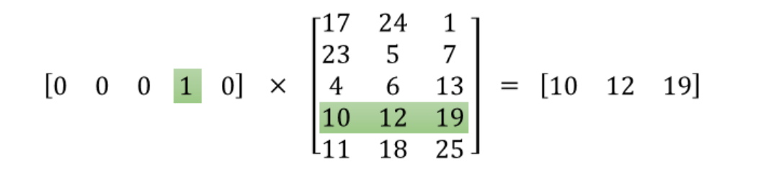
This means that the hidden layer of this model is really just operating as a lookup table. The output of the hidden layer is just the “word vector” for the input word.

Slide 17
The Output Layer
The output layer is a softmax regression classifier.
each output neuron has a weight vector which it multiplies against the word vector from the hidden layer, then it applies the function exp(x) to the result.

Slide 18
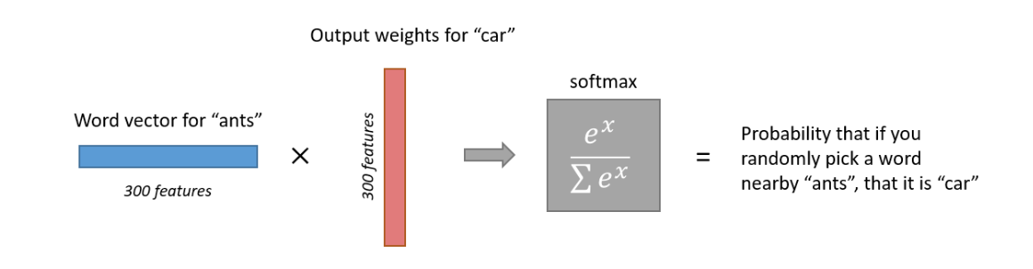
Here’s an illustration of calculating the output of the output neuron for the word “car”.

Slide 19
https://towardsdatascience.com/multi-class-text-classification-model-comparison-and-selection-5eb066197568
http://mccormickml.com/2016/04/19/word2vec-tutorial-the-skip-gram-model/

Slide 20
T-SNE Visualizations
It’s hard to visualize the word embedding directly, for they usually have more than 3 dimensions. T-SNE is a useful tool to visualize high-dimensional data by dimension reduction while keeping relative pairwise distance between points. It can be said that T-SNE looking for a new data representation where the neighborhood relations are preserved. The following code shows how to plot the word embedding with T-SNE plot.
def display_closestwords_tsnescatterplot(model, word, size):
arr = np.empty((0,size), dtype='f')
word_labels = [word]
close_words = model.similar_by_word(word)
arr = np.append(arr, np.array([model[word]]), axis=0)
for wrd_score in close_words:
wrd_vector = model[wrd_score[0]]
word_labels.append(wrd_score[0])
arr = np.append(arr, np.array([wrd_vector]), axis=0)
tsne = TSNE(n_components=2, random_state=0)
np.set_printoptions(suppress=True)
Y = tsne.fit_transform(arr)
x_coords = Y[:, 0]
y_coords = Y[:, 1]
plt.scatter(x_coords, y_coords)
for label, x, y in zip(word_labels, x_coords, y_coords):
plt.annotate(label, xy=(x, y), xytext=(0, 0), textcoords='offset points')
plt.xlim(x_coords.min()+0.00005, x_coords.max()+0.00005)
plt.ylim(y_coords.min()+0.00005, y_coords.max()+0.00005)
plt.show()
>>> display_closestwords_tsnescatterplot(model, 'Porsche 718 Cayman', 50)

Slide 21

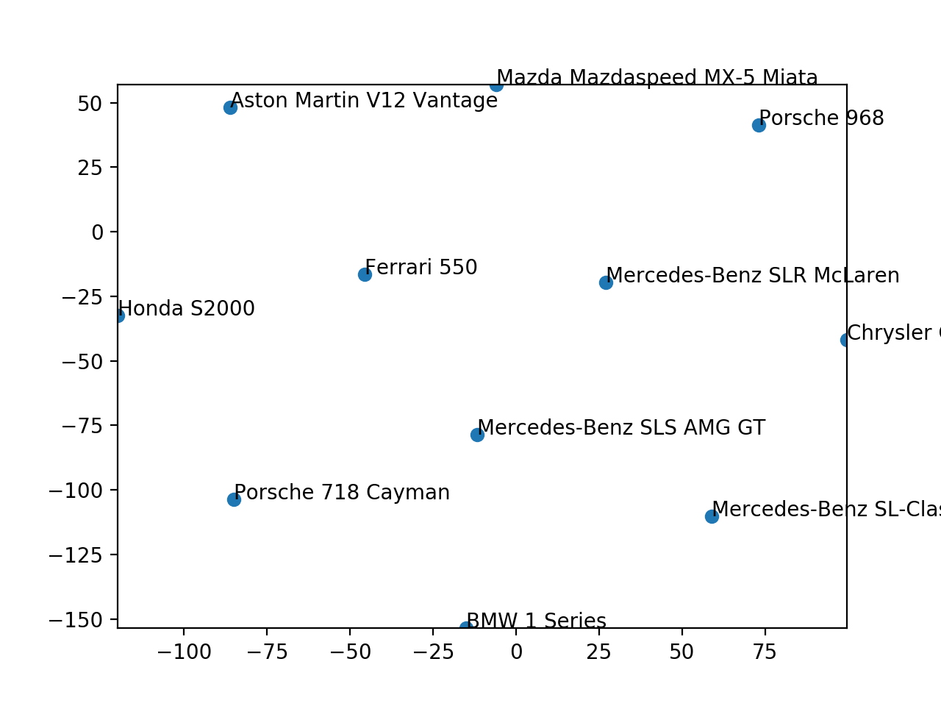
T-SNE Visualizations
It’s hard to visualize the word embedding directly, for they usually have more than 3 dimensions. T-SNE is a useful tool to visualize high-dimensional data by dimension reduction while keeping relative pairwise distance between points. It can be said that T-SNE looking for a new data representation where the neighborhood relations are preserved. The following code shows how to plot the word embedding with T-SNE plot.
def display_closestwords_tsnescatterplot(model, word, size): arr = np.empty((0,size), dtype='f') word_labels = [word]close_words = model.similar_by_word(word)arr = np.append(arr, np.array([model[word]]), axis=0) for wrd_score in close_words: wrd_vector = model[wrd_score[0]] word_labels.append(wrd_score[0]) arr = np.append(arr, np.array([wrd_vector]), axis=0) tsne = TSNE(n_components=2, random_state=0) np.set_printoptions(suppress=True) Y = tsne.fit_transform(arr)x_coords = Y[:, 0] y_coords = Y[:, 1] plt.scatter(x_coords, y_coords)for label, x, y in zip(word_labels, x_coords, y_coords): plt.annotate(label, xy=(x, y), xytext=(0, 0), textcoords='offset points') plt.xlim(x_coords.min()+0.00005, x_coords.max()+0.00005) plt.ylim(y_coords.min()+0.00005, y_coords.max()+0.00005) plt.show()>>> display_closestwords_tsnescatterplot(model, 'Porsche 718 Cayman', 50)
This T-SNE plot shows the top 10 similar vehicles to the Porsche 718 Cayman in two-dimensional space.

